Slide 1


Data Warehousing
Sarvajanik College of Eng. & Tech.(SCET) MCA Department
Present By:
Viradiya Ruteeka Sureshbhai
ET22MTCA131
Subject Guide:
Prof. Mayank Jain
Prof. Riddhi Patel

Slide 2
Agenda
Introduction
Need for Data Warehouse
Goals of Data Warehouse
Benefits of Data Warehouse

Slide 3
Introduction
A Data Warehouse (DW) is data management system that stores large amount of data for later use in Processing and Analysis.
Data mining is incomplete without data warehousing.
Data warehousing is not just limited to storage but is also responsible for the maintenance and security of data.

Slide 4
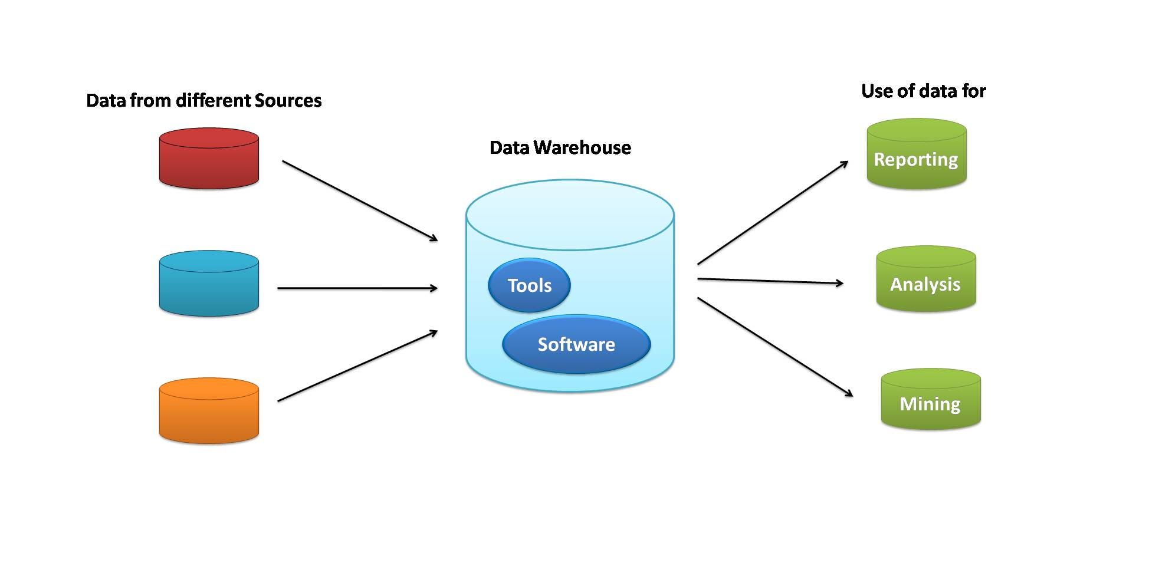
ETL

Slide 5
Need For Data Warehouse
For taking quick and effective decision.
Helps users in providing necessary information.
Creating and managing efficient data repository

Slide 6

Goals of Data Warehouse
Secured and easy access of information to user.
Consistent information to be provided.
Clean and authentic data for analysis.
Data Collected must be accurate and verified.
Data must be adaptive in nature.

Slide 7

Benefits of Data Warehouse
Historical information is provided to Analyst
Increase Quality of Data
Helps in Recovering from database failure
Helps in Data mining process
Better Business Intelligence

Slide 8
Thank you

